Slide 1
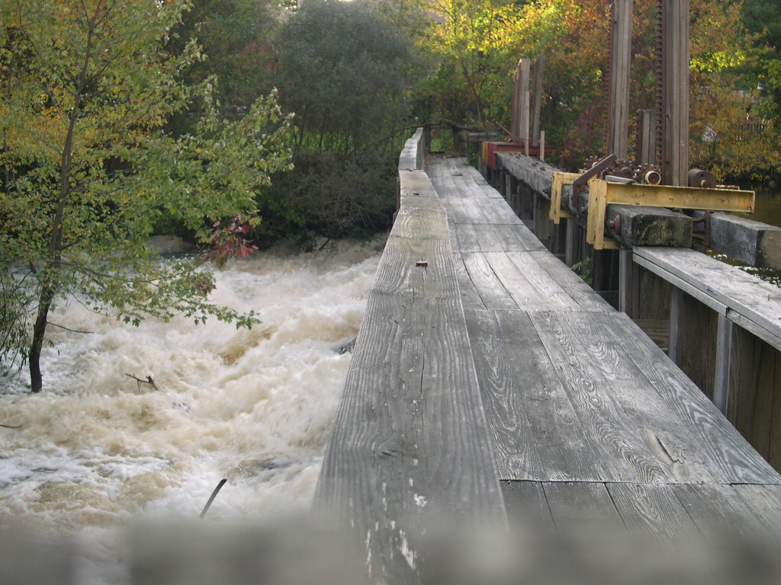
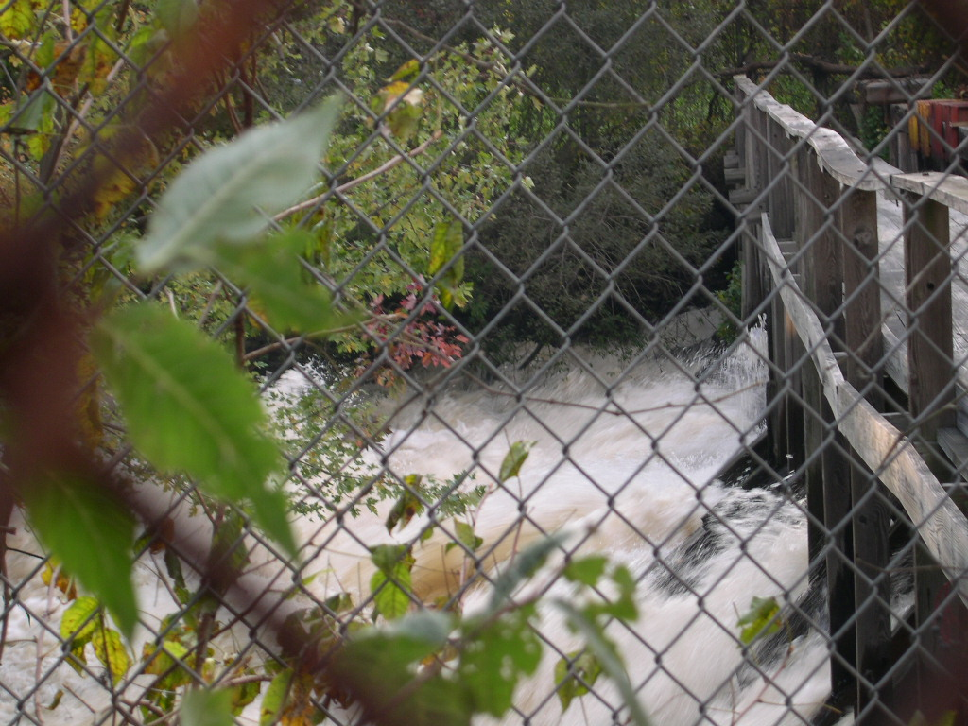
A Review of the Whittenton Dam Crisis
David R. Vallee
Hydrologist-in-Charge
NWS Northeast River Forecast Center, Taunton, MA
Nicole M. Belk
Senior Service Hydrologist
NWS Weather Forecast Office, Taunton, MA

Slide 2
Objectives
Review Hydro-meteorological evolution of events leading up to the potential dam failure
Examine the flood potential should the Whittenton Pond and/or Morey’s Bridge Dam had failed
Discuss the WFO/RFC capabilities to provide support during dam failure events

Slide 3
Hydro-met perspective
Back to back prolific rainfall events
October 7-9 and October 13-16
First system dropped 3-5 inches
Second system dropped 6-8 inches
Both systems were linked to the deep tropics – deep moisture plume

Slide 4
Round One: Tropical Storm Tammy remnants and a slow moving frontal system
October 7-9, 2005

Slide 5
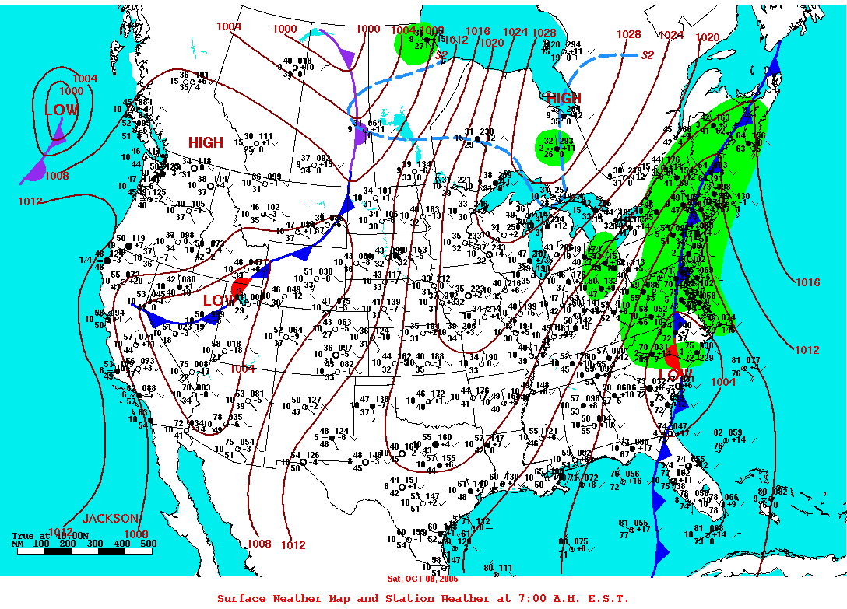

Slide 6
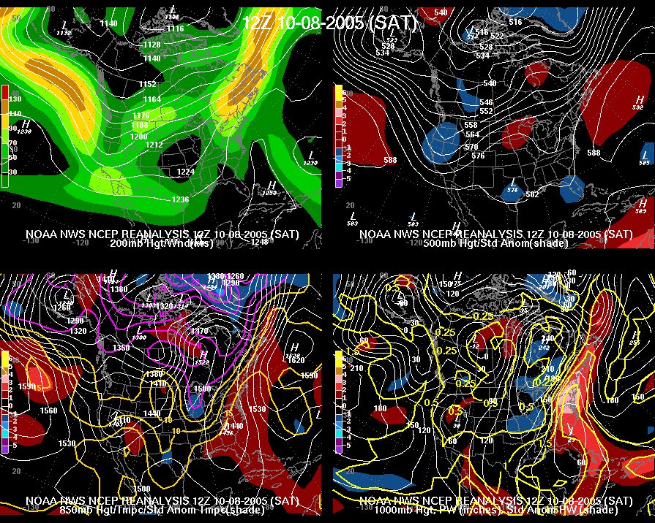

Slide 7
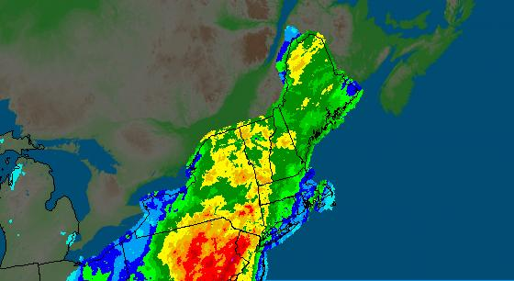
24 Hour Precipitation for October 8th, 2005

Slide 8
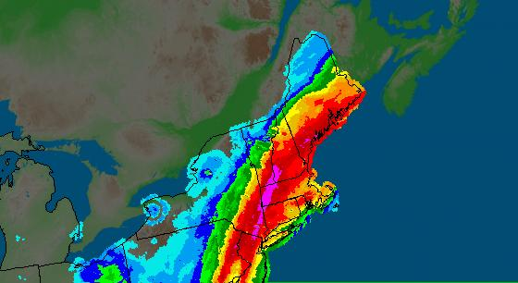
24 Hour Precipitation for October 9th, 2005
SE Massachusetts
Event Total: 3-5”

Slide 9
Round Two: Off-shore storm development and remnants of Subtropical TD 22
October 13-16, 2005

Slide 10
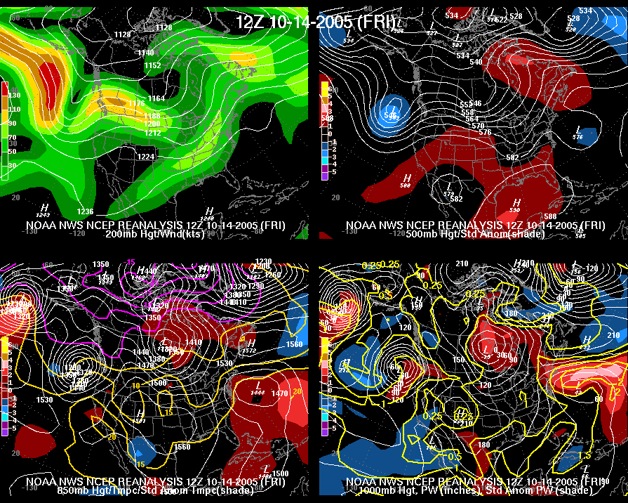

Slide 11
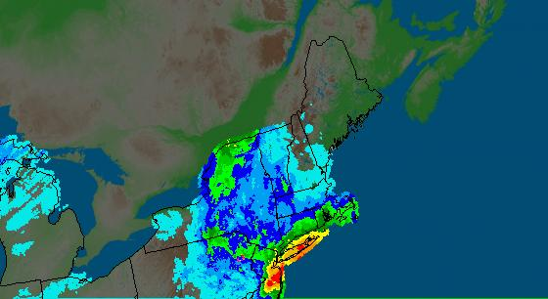
24 Hour Precipitation for October 14th, 2005

Slide 12
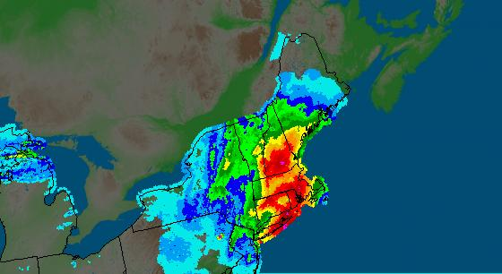
24 Hour Precipitation for October 15th, 2005

Slide 13
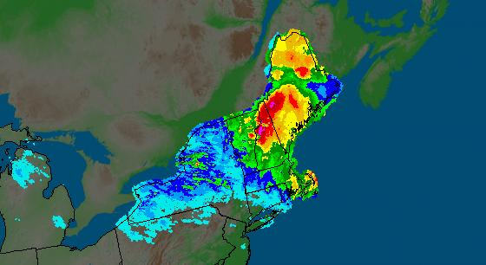
24 Hour Precipitation for October 16th, 2005
SE Massachusetts
Event Total: 6-8”
(most of this fell in a 6 to 12 hour period)

Slide 14
Examining the Potential Dam Failure(s)
Crisis began 3 pm, Monday, Oct 17th
Taunton EMA called in the imminent failure of Whittenton Dam on the Mill River
Just upstream of the city center
Two structures at risk:
Most immediate concern: Whittenton Dam
Built in the late 1800s, limited refurbishment in 1950s
Complicating matters: Morey’s Bridge Dam
Holding back Lake Sabattia

Slide 15
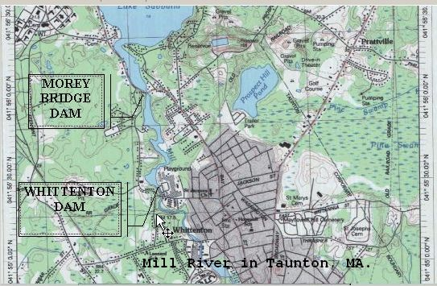

Slide 16
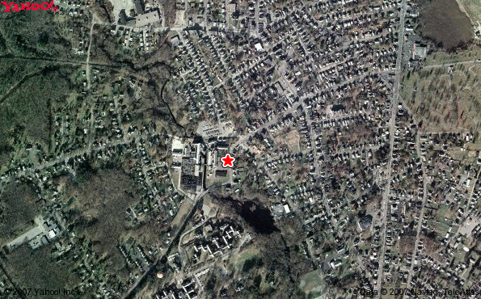
Whittenton Pond Dam
Downtown Taunton, MA

Slide 17
NWS Capabilities What we need from you
Have your local NWS office high on the local notification list for dams in your area
High Hazard dams have Emergency Action Plans (EAPs) – ensure the NWS is high on the notification tree
Most important information for the dam:
The correct name of the dam!
County & town the dam is located
River, stream or lake the dam is on
NID or State ID, Dam Type (earth, concrete)
Condition of the dam
Width of breach
Is the failure in progress or imminent
Is the pool/lake full, ½ full, etc.

Slide 18
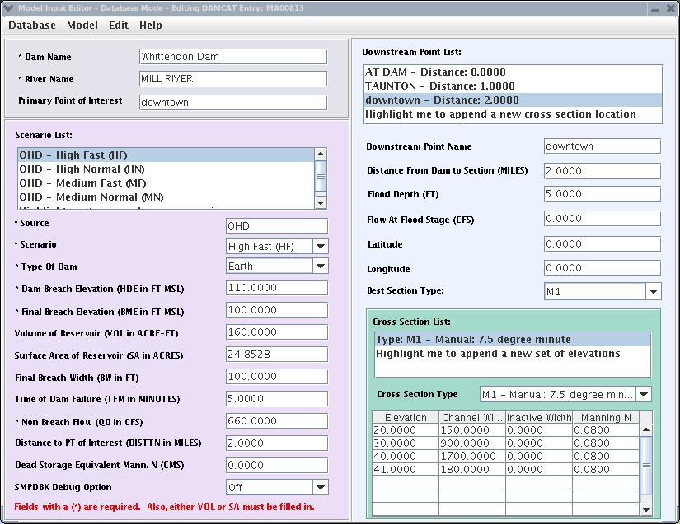
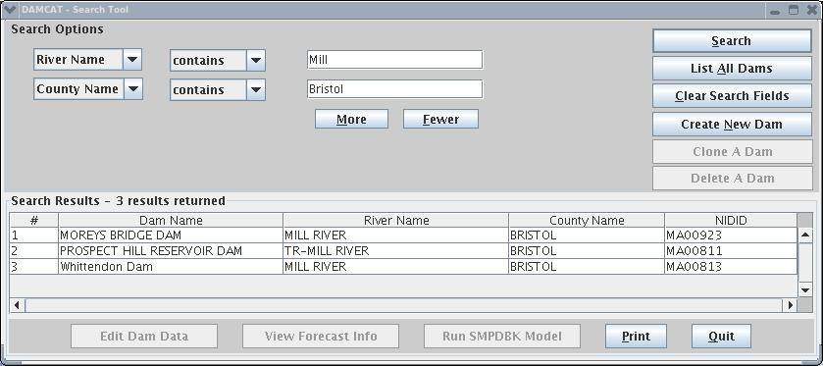
NWS Capabilities What we will provide you
Initial estimate of flood wave and the time to reach the nearest downstream location
For Whittenton Dam – a Flash Flood Warning was issued almost immediately after notification from EMA
Time to fail = 5 minutes; a flood wave producing a peak depth of 5 feet reaching downtown Taunton in ~ 20 minutes

Slide 19
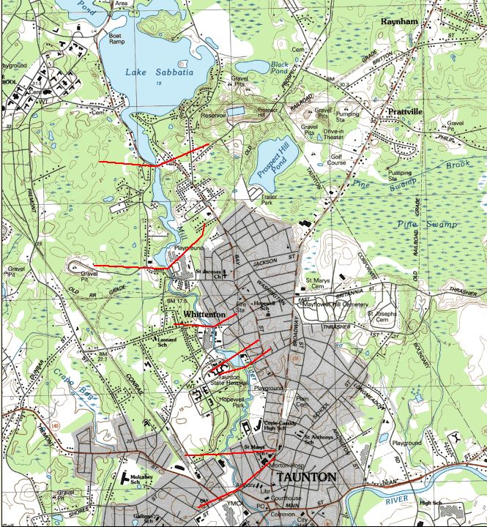
Scenario One: Whittenton Fails
Additional Capabilities If Time Allows!

Slide 20
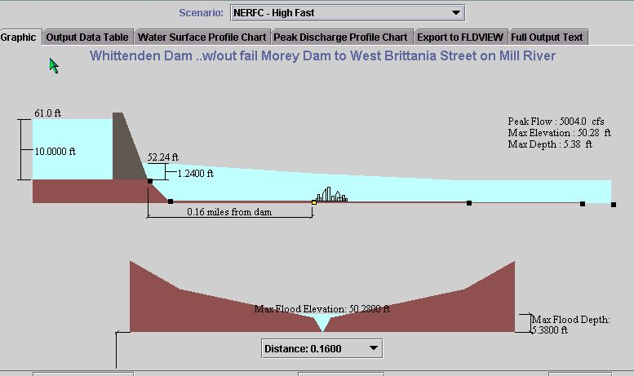
City of interest: Taunton
Time elapsed from failure to Peak depth at Taunton: 8-14 minutes
Peak depth of flood: 5.4 feet – flood elevation exceeded for 1 hour

Slide 21
Additional Capabilities If Time Allows!
Scenario Two: Morey’s Bridge and Whittenton Fail

Slide 22
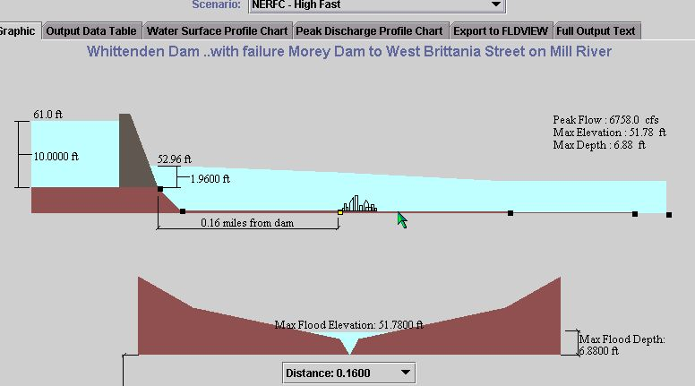
City of interest: Taunton
Time elapsed from failure to Peak depth at Taunton: 20 minutes
Peak depth of flood: 6.9 feet - flood elevation exceeded for ~ 12-18 hours
Notes:
Schematic showing dam and flood wave through Taunton. Important depth/timing information provided in the text box.

Slide 23
As for the eventual outcome… A near-failure as the USACE was successful in an emergency operation to draw down the pool and gracefully take down the dam!
In just a matter of hours – note the bowing of the wooden structure!

Slide 24
USACE to the rescue – While NWS watched Hurricane Wilma like a Hawk They need 84 hours to pull this off – Hurricane Wilma brought rains as forecast ~ hour 96!
During The Flooding
The New Dam

Slide 25
NWS Response
WFO Taunton was notified 3 pm October 17th – Flash Flood Warning was issued for imminent failure
Upon issuance, the city of Taunton ordered evacuations of all downstream areas in the floodplain
Shut down businesses, schools, city offices
RFC/WFO teamed to produce dam breach simulations (DamCrest) program
WFO/RFC provided both remote and on-site Decision Support to the city of Taunton through the following weekend

Slide 26
A Review of the Whittenton Dam Crisis
David R. Vallee
Hydrologist-in-Charge
NWS Northeast River Forecast Center, Taunton, MA
Nicole M. Belk
Senior Service Hydrologist
NWS Weather Forecast Office, Taunton, MA

